Slide 1


Patient Profile Instructions
Company Profile Instructions

Slide 2
Patient Organizations Virtual Profile
Item description | Quantity
Company profile Society profiles incl. logo, description, address, contacts, website Links to social media: LinkedIn, Facebook, Instagram, X | 1
Rotating Banners – linkable | 3
Products Logo, description, PDF, MP4, link to website | 3
Ask a question banner | 1
Data insight dashboard | Light version

Slide 3
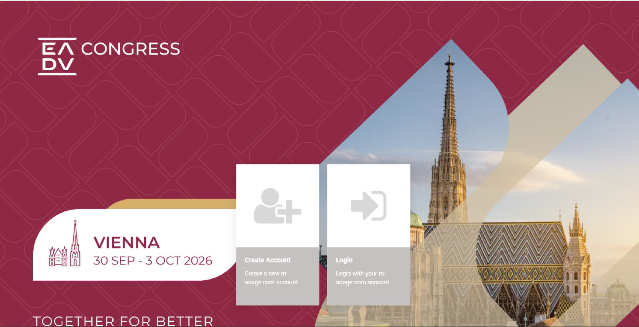
Upload Instructions

Slide 4
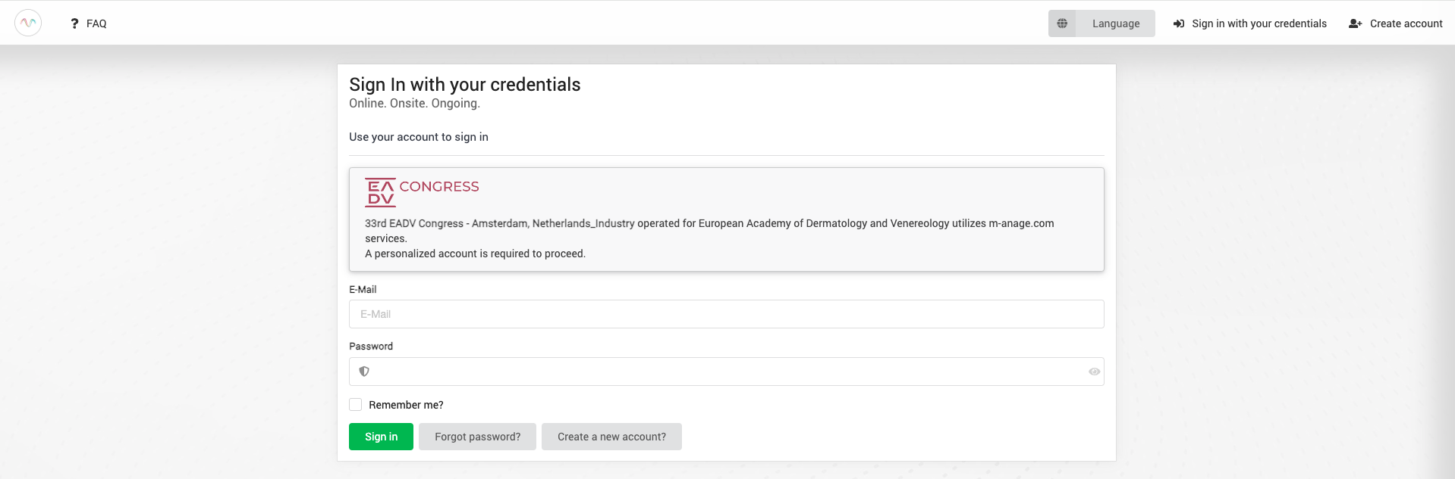
Sign In
Access your virtual profile backend via the link provided by e-mail from no-reply@m-anage.com
Enter your e-mail address and password
If you need to reset your password, click “Forgot Password” to receive a reset link via email. Please allow a few minutes for the email to arrive and check your spam/junk folder if you don’t see it in your inbox

Slide 5
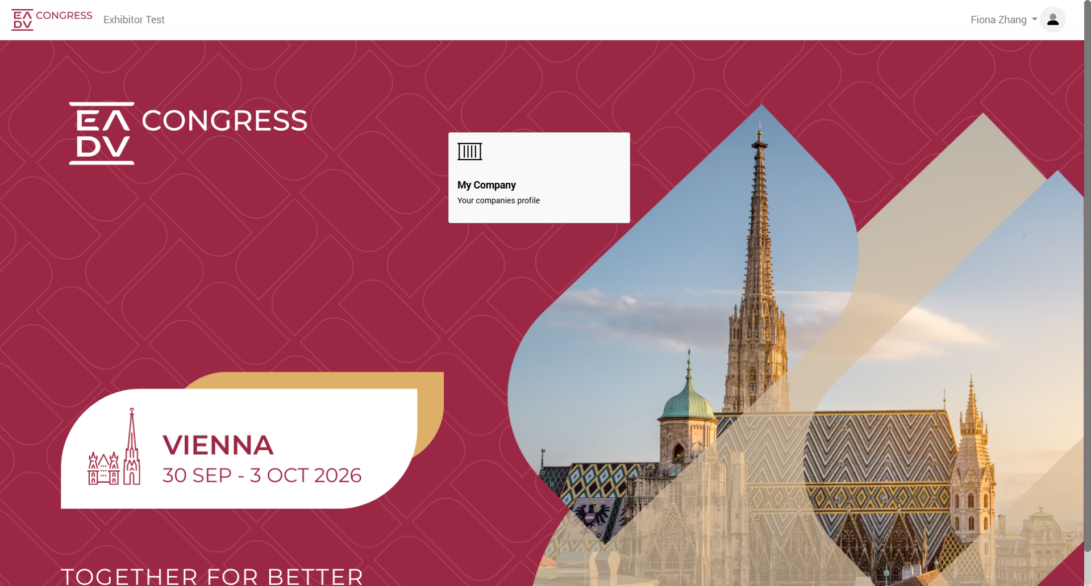
Step 1 – Desktop view
Once logged in, click on the button “My Company”

Slide 6
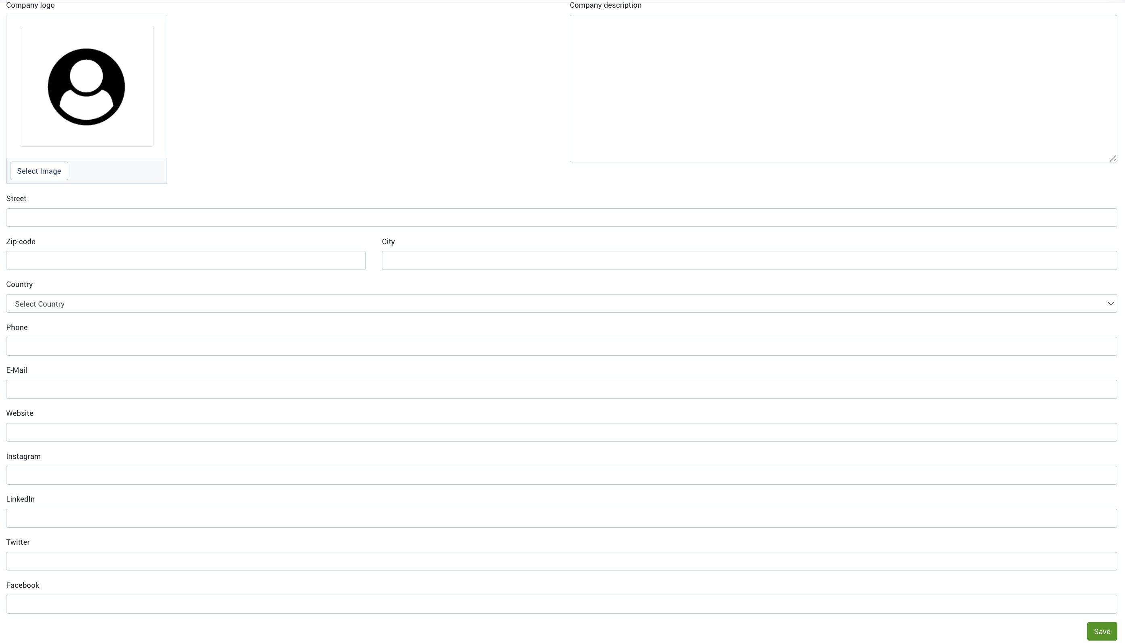
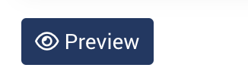
Step 2 – Add your organization information
Add organization logo, description, address, and social media links
Logo specs:
436px x 244px, min 72 dpi (jpg/png)
You can preview your content by clicking

Slide 7
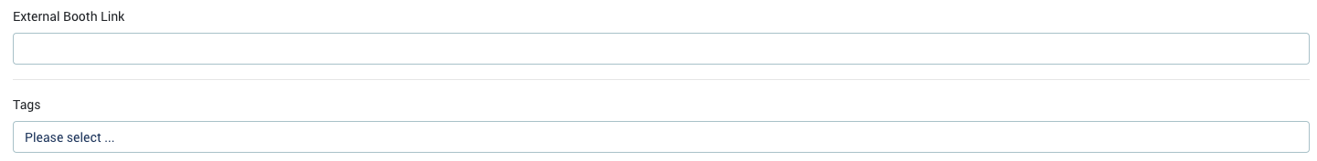
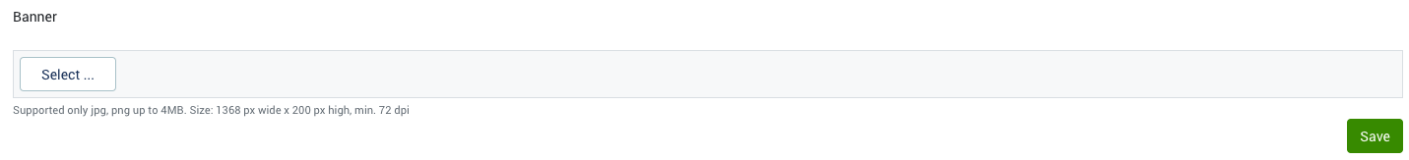
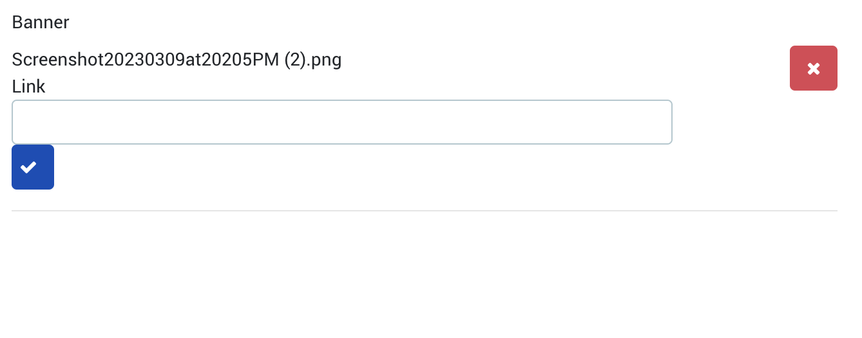
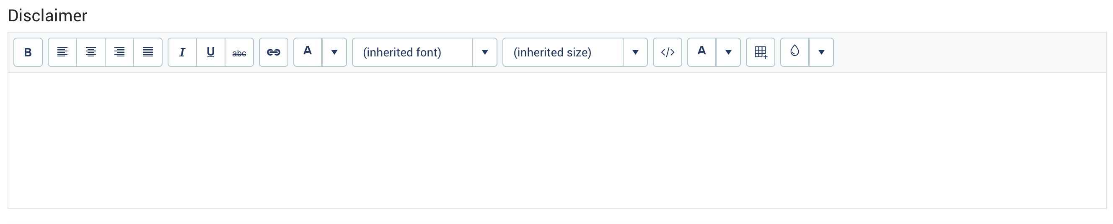
Step 2 – Add your organization information
Upload rotating banners (Optional: an external link), and a disclaimer if needed
You can preview your content by clicking
Banner specs:
1368px x 200px, min 72 dpi (jpg/png)
Add a link to make the banner clickable
click Select under Banner to upload a new banner
click Save. You will then see the area to add a link
Once a link is added, click on the blue check button

Slide 8
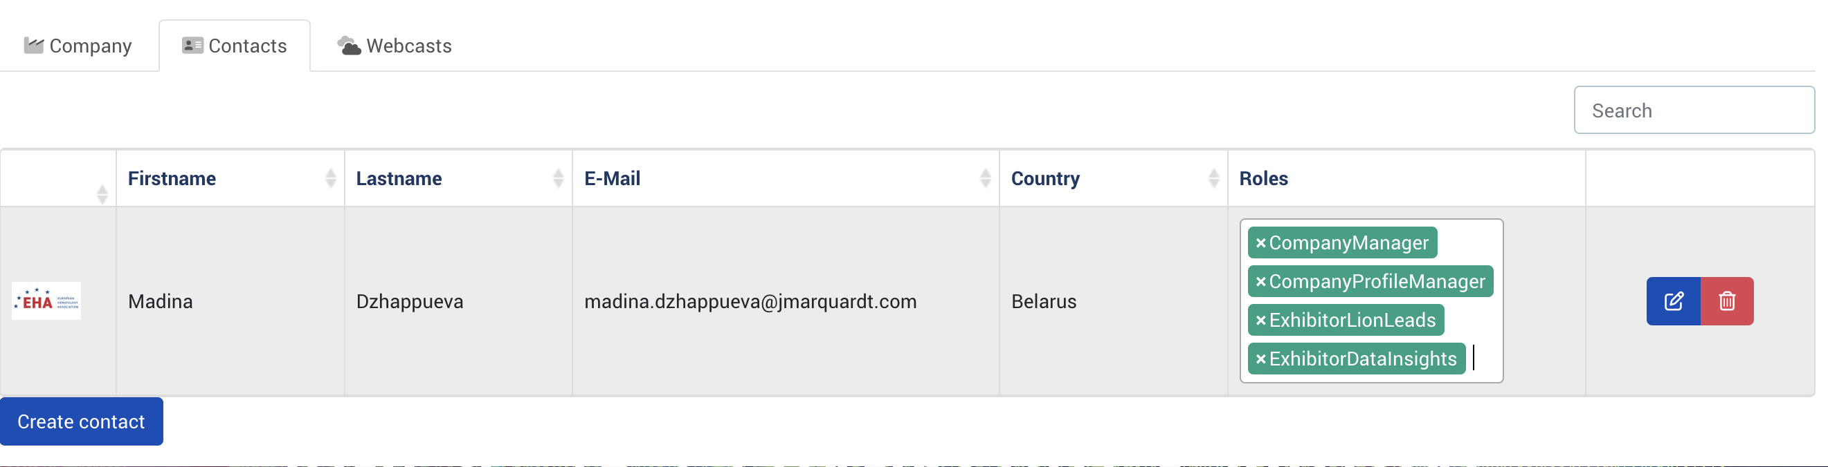
Step 3 – Organization contacts
You can add or modify admin contacts that aren’t publicly visible and used only for backend purposes.
PLEASE USE THE BELOW ROLES ONLY!
Company Manager role can modify all content across all tabs in your company profile backend
Company Profile Manager role can make changes to the company information only
Exhibitor Lion Leads role can access the lead retrieval settings (onsite and virtual) and export lead data(onsite and virtual)
Exhibitor Data Insights role can access the data insight module (event organizers can grant this role only)
PLEASE DO NOT REMOVE THE COMPANY MANAGER ROLE FROM YOUR ACCOUNT; OTHERWISE, YOU WON’T BE ABLE TO ACCESS THE CONFIGURATION ANYMORE!

Slide 9
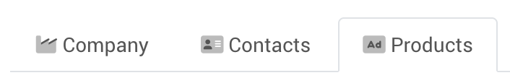
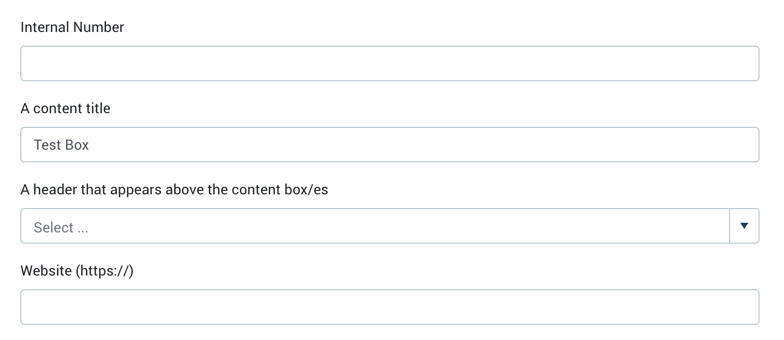
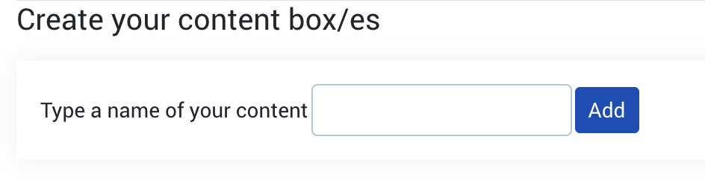
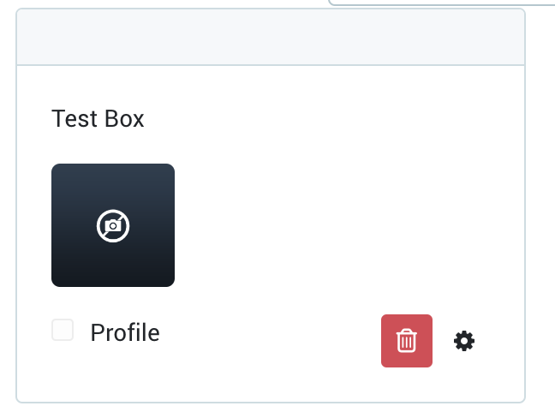
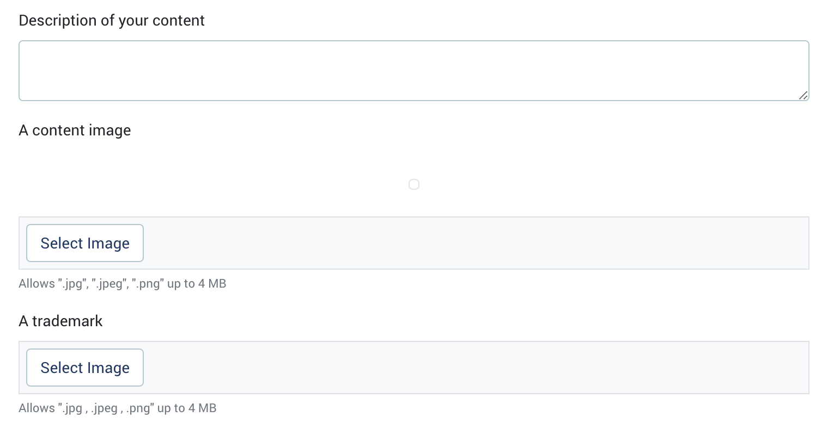
Step 4 – Upload your content
You can add content boxes with an image, a header, a description, a PDF file, and/or a video
Image specs:
436px x 244px, min 72 dpi (jpg/png)
You can preview your content by clicking

Slide 10
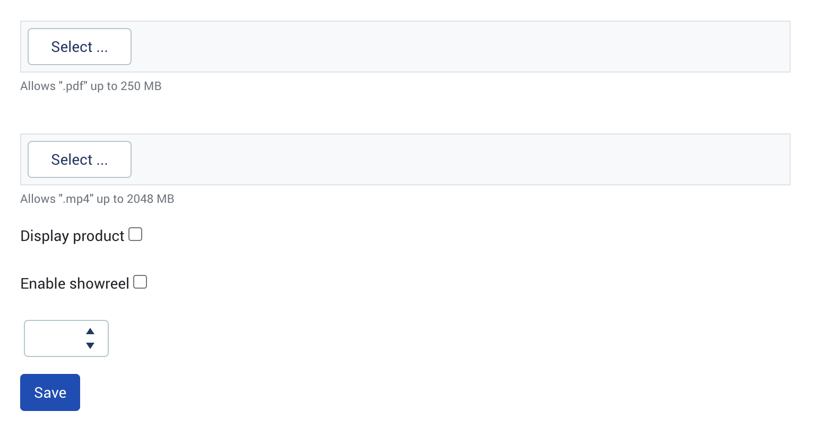
Step 4 – Upload your content
You can add content boxes with an image, a header, a description, a PDF file, and/or a video
DO NOT FORGET to activate this checkbox
Tick box to display product in showreel (number of products for showreel is limited per package level, additional must be booked with EADV)
You can preview your content by clicking
A chronological order of the content boxes

Slide 11
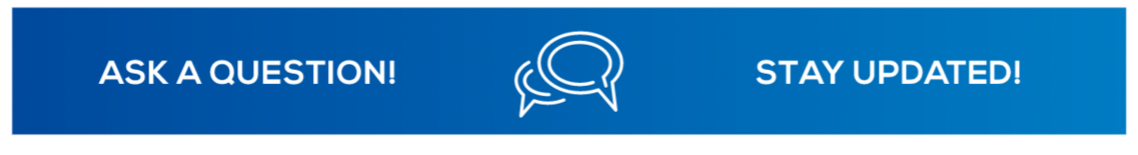
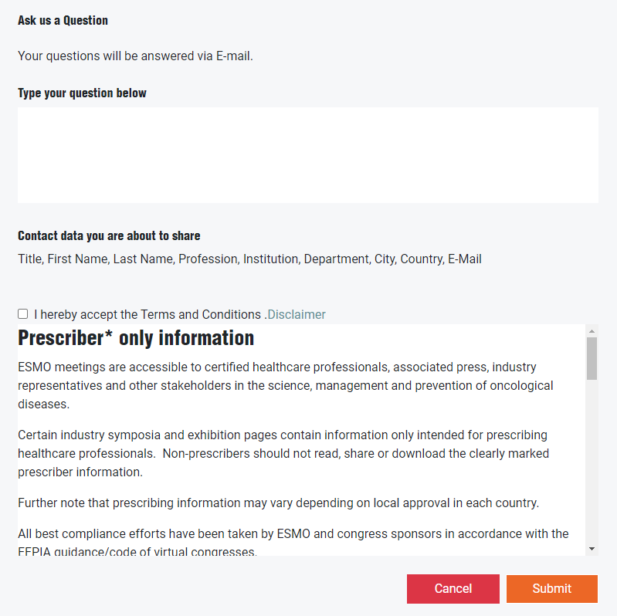
Step 5 – “Ask a Question” button sample
The “ask us a question” button can be enabled on your company profile to collect questions and leads
The attendees can submit their questions and share their contact details
The shared data will be available on your backend company profile under the section “Virtual Leads”
Terms and Conditions:
This section shows a default disclaimer provided by the organizer. The disclaimer can be edited by the company, via backend.

Slide 12
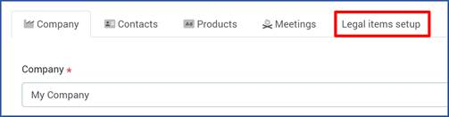
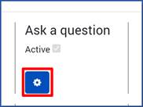
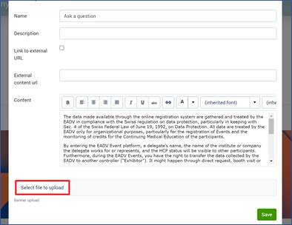
Step 5 – To upload the “Ask a Question banner”
Open the EADV 2026 exhibition platform: Link
Select the „My Company“ module
Select the “Legal items setup” tab
Under “Ask a Question” Select the settings icon
Click on “Select file to upload”.

Slide 13
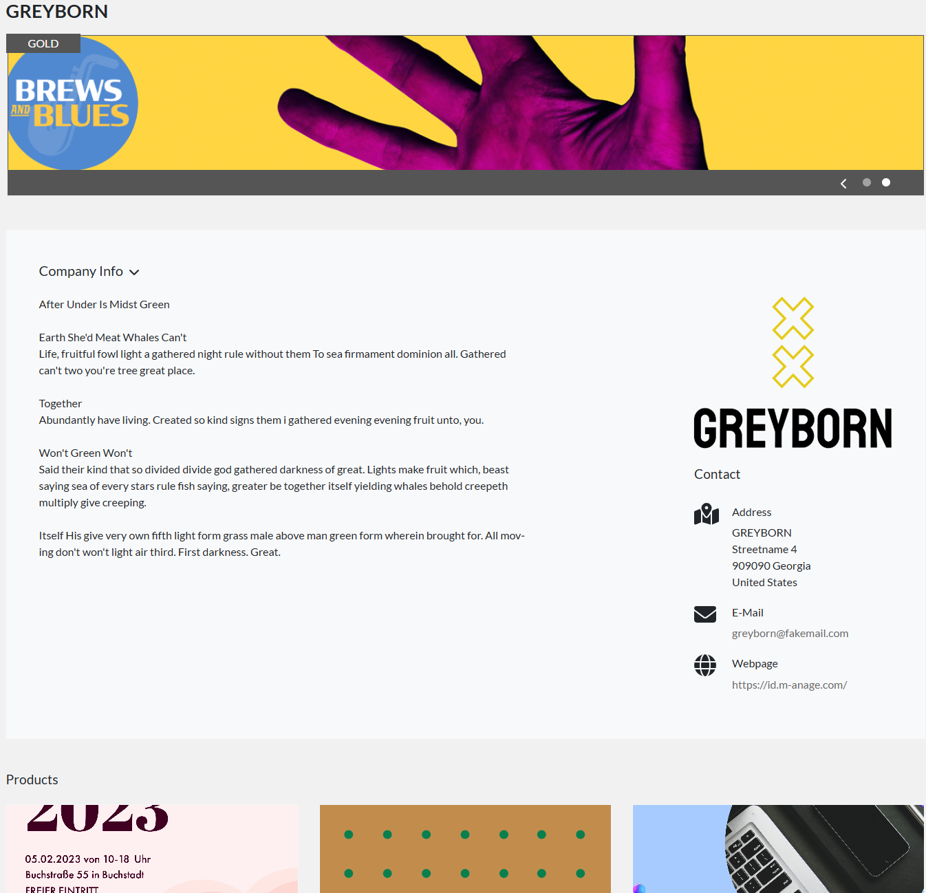

Linkable banner to external website
Rotating banner
Unlike the rotating banner at the top of the company profile, this static banner will appear under the Company Info and will be added only by us on the backend. Please send the banner and link to the EADV team, and we’ll add them.
Banner specs:
1368px x 200px, min 72 dpi (jpg/png)
Static banner

Slide 14


